Slide 1
6CS005 High Performance Computing
Week 5 Hybrid

Slide 2
Parallel Programming Models
Shared Memory Programming
  Processes share memory address space (threads model)
  Application ensures no data corruption (Lock/Unlock/Mutexes)
  POSIX Threads, OpenMP
Directive-based Parallelization
  Compiler needs help
  OpenACC, CUDA
Message Passing
  Explicit communication between processes
  MPI, PVM, Actor

Slide 3
MPI
The Message Passing Interface (MPI) is designed to enable parallel programming through process communication on distributed-memory machines such as networked clusters.
P1
P1
P1
P1
Communication channel

Slide 4
The Message-Passing Model
Based on the notion of multiple processes
  a process is an instance of a running program, together with the program’s data
Parallelism is achieved by having many processes co-operate on the same task
Each process has access only to its own data
  all variables are private/local
Processes communicate by sending and receiving messages
  using library calls from a conventional sequential language for synchronization
  sending data from one process's memory space to another
P1
P1
P1
P1
Communication channel

Slide 5
1. Highly Scalable
  Works well with many computers (from a few to thousands).
  Perfect for big jobs on supercomputers.
2. Efficient Use of Memory
  Each processor uses its own memory, so no need to share one big memory pool.
  This is good for large datasets.
3. Portable
  MPI works on almost any system – clusters, supercomputers, even regular PCs.
  You can move your code across systems with minimal changes.
5. Standardized
  MPI is a well-established standard.
  Supported by many languages (like C, C++, Fortran, Python).
1. Hard to Learn
  MPI programming can be complex, especially for beginners.
  You must manage all communication and synchronization manually.
2. Debugging is Difficult
  Bugs related to timing or data exchange between processors can be tricky to find.
3. Communication Overhead
  Sending messages between processors takes time.
  If not managed well, it can slow down performance.
4. Not Ideal for Shared Memory Systems
  On machines where all processors can access the same memory, other models like OpenMP might be simpler and faster.
5. Load Balancing is Manual
  You have to make sure that each processor gets the right amount of work.
  If one gets too much, it slows down the whole program.

Slide 6
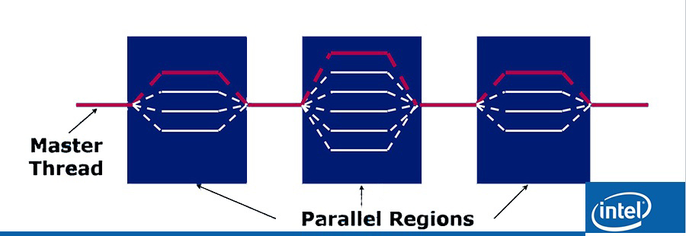
OpenMP
OpenMP is an implementation of multithreading, a method of parallelizing implemented using pragmas whereby a master thread and slave threads, in parallel, jointly perform a task.

Slide 7
1. Easy to Learn and Use
  Just add special comments (called pragmas) to your code.
  Much easier than MPI for beginners.
2. Great for Shared-Memory Systems
  Perfect for desktop PCs, workstations, or single-node servers with many cores.
  All threads share the same memory — no need to send messages.
3. No Manual Message Passing
  Threads can directly access shared variables.
  No need to write code for sending and receiving data.
4. Scales Well (on One Machine)
  Can make good use of 8, 16, 32+ cores on a modern CPU.
5. Flexible Parallelism
  Easy to parallelize loops, sections, or specific parts of code.
  You can control how tasks are split.
1. Limited to Shared Memory
  Only works well on one machine (or one node).
  Doesn't scale across multiple computers like MPI does.
2. Memory Conflicts
  Since threads share memory, you can get race conditions or data conflicts if not careful.
3. Not Ideal for Very Large Systems
  If your program needs hundreds or thousands of cores across multiple nodes, OpenMP isn't enough.
4. Less Control
  You have less fine-grained control over communication and memory than MPI.
5. Performance Tuning Can Be Tricky
  Even though it's easy to use, getting maximum performance often takes tweaking (scheduling, private/shared variables, etc.).

Slide 8
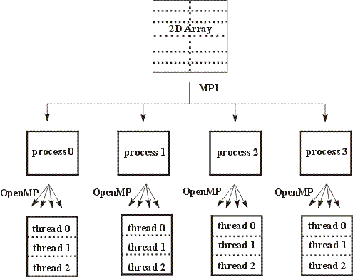
Hybrid (MPI + OpenMP) model
1. Better Scalability
Uses MPI for large-scale systems (clusters).
Uses OpenMP to fully utilize all cores in each machine.
Makes better use of modern multi-core, multi-node hardware.
2. Efficient Memory Use
Reduces memory overhead by using shared memory within each node (via OpenMP).
Less memory duplication compared to using MPI only.
3. Improved Performance
MPI can be slower when too many processes are running.
Hybrid reduces the number of MPI processes and uses threads instead — often faster.
4. Flexible Design
You can fine-tune the balance between MPI tasks and OpenMP threads based on your system and problem.

Slide 9
How to Hybrid
Start with Serial Code
Add MPI to split the work between nodes/processes
Create OpenMP parallel regions inside each MPI process
Use #pragma omp parallel to parallelise loops
Declare private and shared variables properly for OpenMP
Gather results from all processes using MPI
Perform MPI communication as needed (before or after OpenMP regions)
Finalize MPI (MPI_FINALIZE) to close the MPI environment

Slide 10
Serial code
#include <stdio.h>
#include <math.h>
#include <time.h>
double ctimer() {
return (double)clock() / CLOCKS_PER_SEC;
}
int main() {
const long N = 1000000000; // 1e9 steps
const double h = 1.0 / N;
const double PI = 3.141592653589793238462643;
double x, sum = 0.0, pi, error, time;
time = -ctimer();
for (long i = 0; i <= N; i++) {
x = h * (double)i;
sum += 4.0 / (1.0 + x * x);
}
pi = h * sum;
time += ctimer();
error = fabs(pi - PI);
printf("Serial: π = %.16f ± %.16f | time = %.4f sec\n", pi, error, time);
return 0;
}

Slide 11
Omp
#include <stdio.h>
#include <math.h>
#include <omp.h>
int main() {
const long N = 1000000000;
const double h = 1.0 / N;
const double PI = 3.141592653589793238462643;
double x, sum = 0.0, pi, error, start, end;
start = omp_get_wtime();
#pragma omp parallel for private(x) reduction(+:sum)
for (long i = 0; i <= N; i++) {
x = h * (double)i;
sum += 4.0 / (1.0 + x * x);
}
pi = h * sum;
end = omp_get_wtime();
error = fabs(pi - PI);
printf("OpenMP: π = %.16f ± %.16f | time = %.4f sec | threads = %d\n",
pi, error, end - start, omp_get_max_threads());
return 0;
}

Slide 12

MPI
#include <stdio.h>
#include <math.h>
#include <mpi.h>
int main(int argc, char *argv[]) {
const long N = 1000000000;
const double h = 1.0 / N;
const double PI = 3.141592653589793238462643;
double x, sum = 0.0, mypi, pi, error, start, end;
int i, rank, size;
MPI_Init(&argc, &argv);
MPI_Comm_rank(MPI_COMM_WORLD, &rank);
MPI_Comm_size(MPI_COMM_WORLD, &size);
start = MPI_Wtime();
for (i = rank; i <= N; i += size) {
x = h * (double)i;
sum += 4.0 / (1.0 + x * x);
}
mypi = h * sum;
MPI_Reduce(&mypi, &pi, 1, MPI_DOUBLE, MPI_SUM, 0, MPI_COMM_WORLD);
end = MPI_Wtime();
if (rank == 0) {
error = fabs(pi - PI);
printf("MPI: π = %.16f ± %.16f | time = %.4f sec | processes = %d\n",
pi, error, end - start, size);
}
MPI_Finalize();
return 0;
}

Slide 13
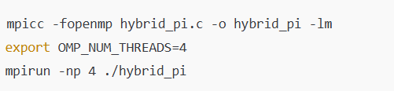
Hybrid
…
#include <mpi.h>
#include <omp.h>
int main(int argc, char *argv[]) {
const long N = 1000000000;
const double h = 1.0 / N;
const double PI = 3.141592653589793238462643;
double x, sum = 0.0, mypi, pi, error, start, end;
int rank, size;
MPI_Init(&argc, &argv);
MPI_Comm_rank(MPI_COMM_WORLD, &rank);
MPI_Comm_size(MPI_COMM_WORLD, &size);
start = MPI_Wtime();
#pragma omp parallel for private(x) reduction(+:sum)
for (long i = rank; i <= N; i += size) {
x = h * (double)i;
sum += 4.0 / (1.0 + x * x);
}
mypi = h * sum;
MPI_Reduce(&mypi, &pi, 1, MPI_DOUBLE, MPI_SUM, 0, MPI_COMM_WORLD);
end = MPI_Wtime();
if (rank == 0) {
error = fabs(pi - PI);
printf("Hybrid: π = %.16f ± %.16f | time = %.4f sec | %d MPI × %d OMP\n",
pi, error, end - start, size, omp_get_max_threads());
}
MPI_Finalize();
return 0;
}

Slide 14
End

